Slide 1

An Orbit of Jupyter Notebooks
Brian Smith
Co-Organizer for PyData Indy

Slide 2


A Little About Me.
Indianapolis
Brian Smith
Agile Systems Developer
Department of Defense
MA Public Admin & BS Finance
Ball State University
Husband, Dad, Tailgater
Python enthusiast since 2013

Slide 3
Our Focus
Indianapolis
Project Jupyter Overview
Documentation, Extensions, & Uses
Analysis & Visualization
Proving Einstein w/ Numpy, SciPy, Matplotlib
Web Scrape Wunderground Data
Urlib, BeatifulSoup, & Pandas
Resources
GitHub
More About @PyDataIndy & Upcoming Schedule

Slide 4

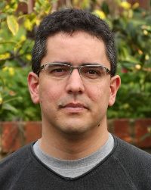
Project Jupyter
Open Source
Derived from IPython Notebook
Interactive & Collaborative
Documented Record of Analysis
Kernels for Python, R, Julia, Ruby, more...
Types of Cells for Jupyter Notebooks
Code
Markdown
Raw NBConvert (ex. LaTeX)
Fernando Perez
Staff Scientist (PhD)
Berkeley Institute for Data Science
(BIDS)

Slide 5
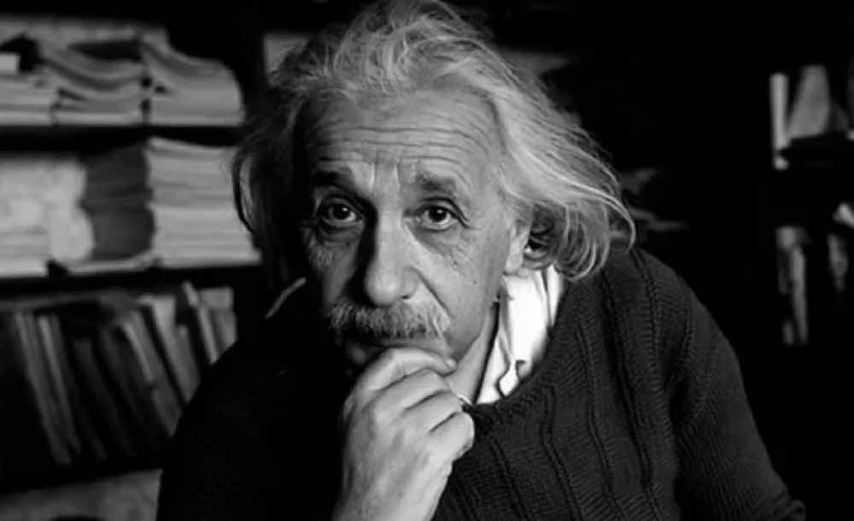

Analysis & Visualization
AND THEN I WAS ALL LIKE…
“SPACE IS FABRIC, YO.”
LIGO – Gravitational Waves (Signal Processing)
Daily Mail: “…Scientists Detect Gravitational Waves…”

Slide 6

Web Scrape Wunderground Data
GitHub | PyData Indy

Slide 7
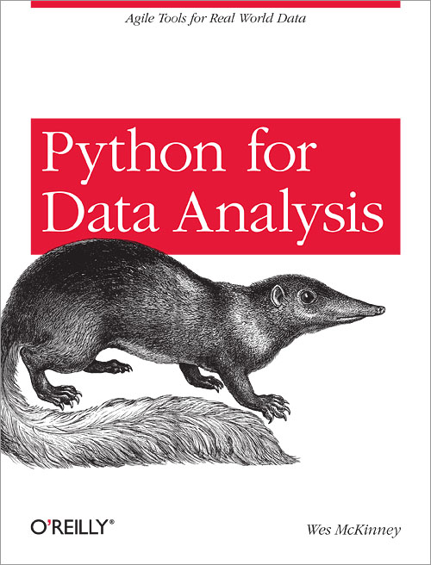
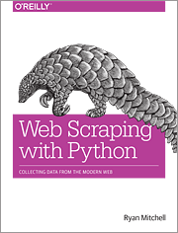
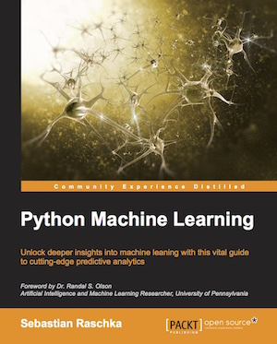
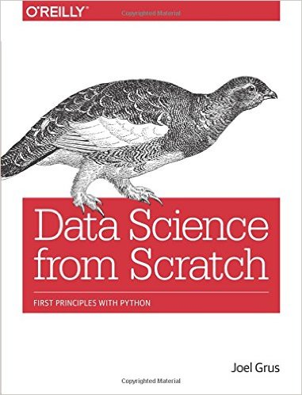
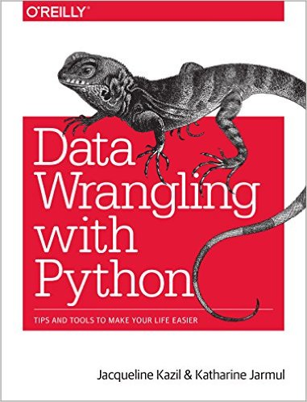

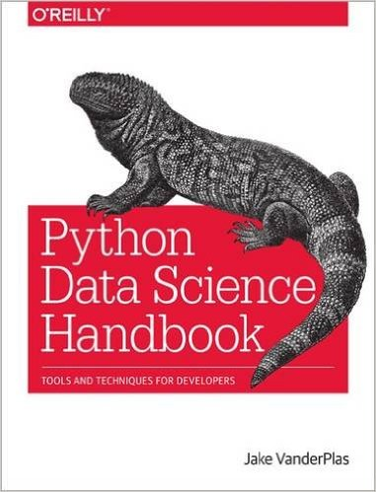
Some Recommends
Python Data Science Handbook
Jake VanderPlas
(Due Out June 2016)

Slide 8
Upcoming Events
Indianapolis
Saturday, March 26th at 2:00 PM
Python Saturday 101
Indianapolis Public Library – College Avenue Branch
Thursday, March 31st at 6:30 PM
PyData Happy Hour (Informal)
Tomlinson Tap Room, City Market (Downtown)
Saturday, April 23rd at 2:00 PM
PyData Saturday, Data Analysis & Visualization
Indianapolis Public Library – Spades Park Branch
Saturday, May 14th at 2:00 PM
PyData Saturday, Case Studies for Statistical Models
Indianapolis Public Library – Spades Park Branch
Sponsorships & Leadership Opportunities
Please see me or email us if you would like to become involved with the PyData Indy team.
PyDataIndy@gmail.com
Additional Events May Added : Check Meetup For Latest Updates.

